Slide 1

Illustra: Unlock Insights, Unleash Innovation
Universal Data Visualization & AI Training, Simplified. Illustra empowers businesses with accessible, AI-driven analytics.
Team members :
Ishaan Patel ,
Mayank Singh ,
Aryan Gupta ,
Aryan Singh.

Slide 2
The Data Deluge: A Growing Challenge
97.3% of companies are planning to invest in Big Data and AI. By 2025, global data will reach 175 zettabytes.
Traditional analytics tools are complex, slow, and expensive.

Slide 3
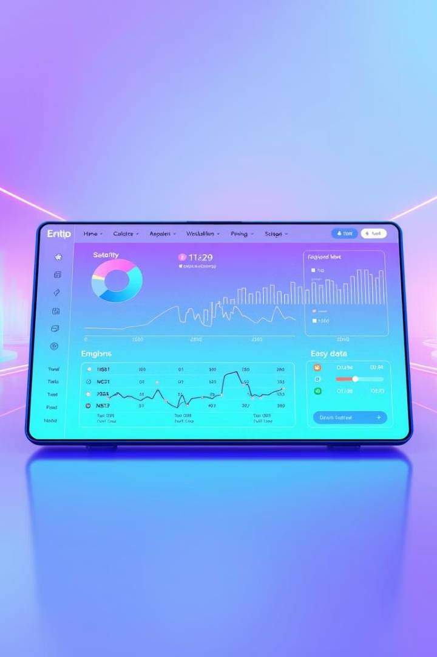
Introducing Illustra: No-Code AI-Powered Analytics
1
Effortless Insights
2
Rapid Deployment
Illustra empowers users to transform raw data into actionable insights.
Go from data to insights in 10 minutes with our intuitive no-code interface.
3
Automated Pipelines
Automate insights with our AI-powered data pipelines.

Slide 4





Key Features: Power & Simplicity
Universal Data Connectivity
AI-Assisted Visualization
Built-in ML Training
Seamlessly connects to all your data sources (SQL, NoSQL, Cloud Storage, APIs).
Suggests optimal charts and graphs based on data type.
Train and deploy machine learning models with zero coding.
Real-time Collaboration
Share insights and collaborate with your team.

Slide 5




Illustra in Action: Real-World Use Cases
Marketing Optimization
Increase ad conversion rates by 30% through AI-powered audience segmentation.
Supply Chain Efficiency
Reduce inventory costs by 15% with predictive demand forecasting.
Financial Prediction
Increase stock prediction accuracy by 25% with automated ML.

Slide 6

Illustra vs. The Competition: A Clear Advantage
Feature
Illustra
Tableau
Power BI
DataRobot
Coding
No-code
Complex
Limited
Complex
AI
AI-powered
Manual Configuration
Basic
Requires Data Scientists
Connectivity
Universal Connectivity
Limited AI
Costly Implementation
High Cost
Cost
Affordable
Expensive
Costly Implementation
High Cost

Slide 7
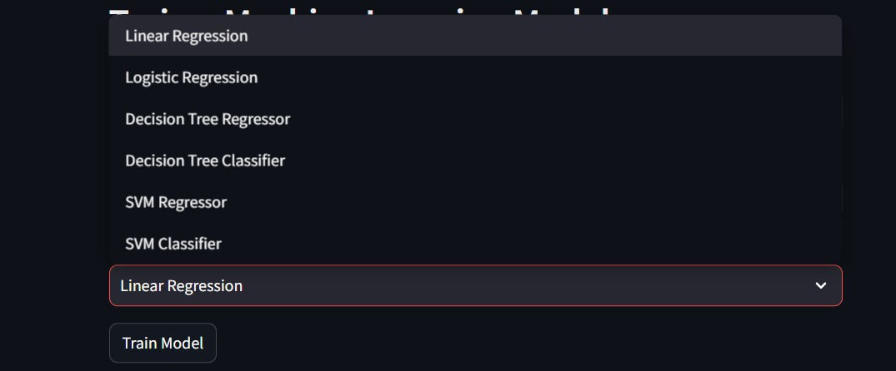
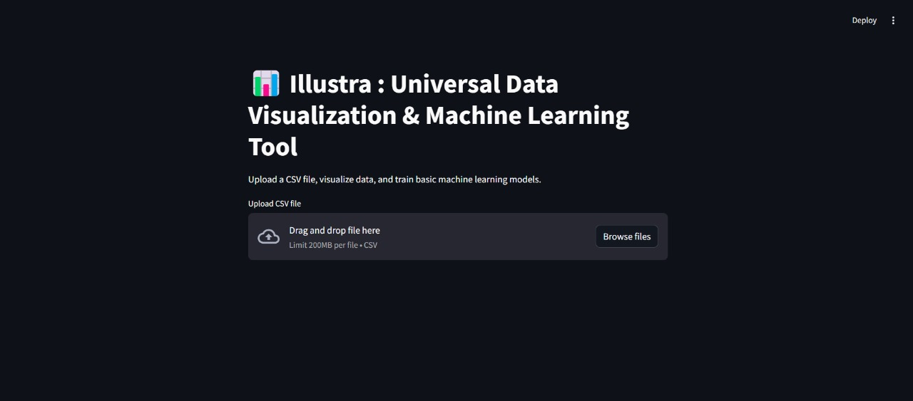
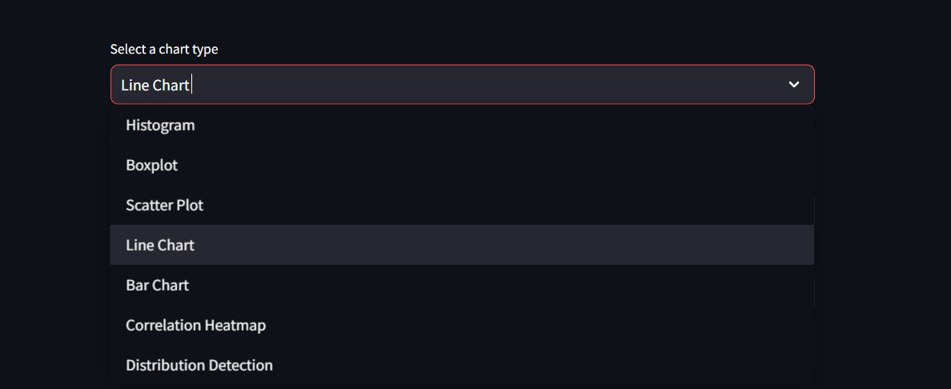
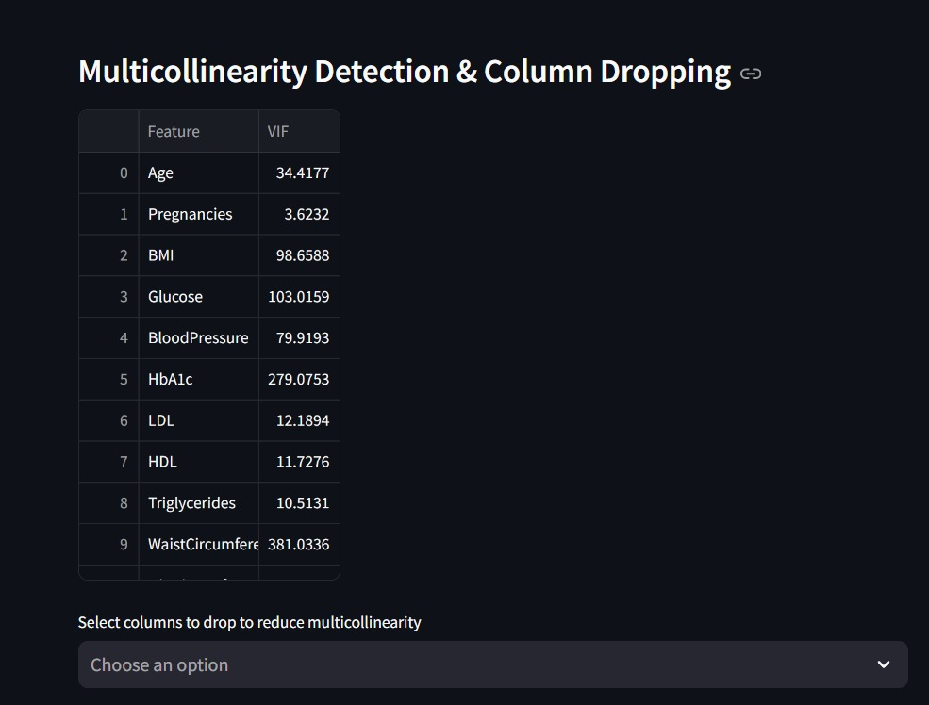

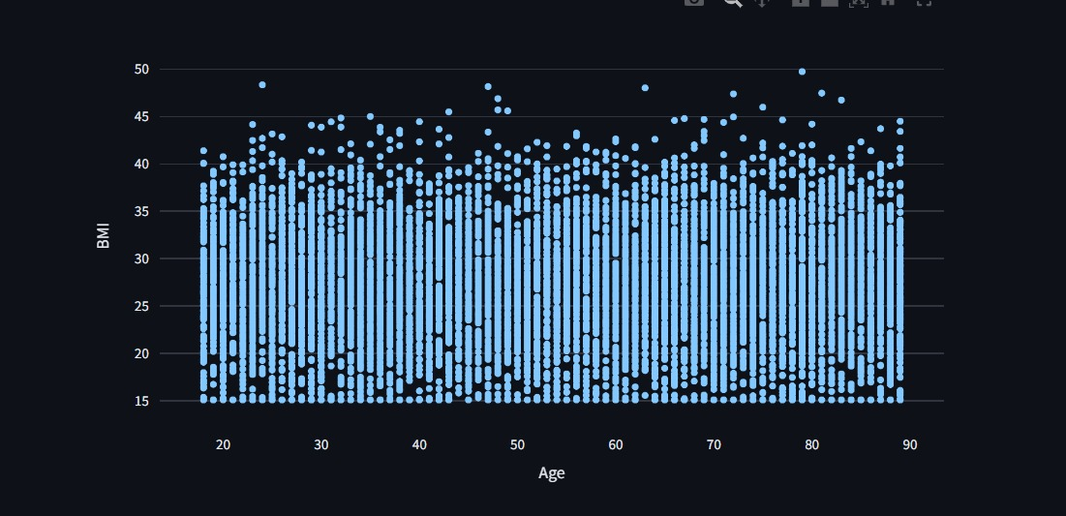

Slide 8

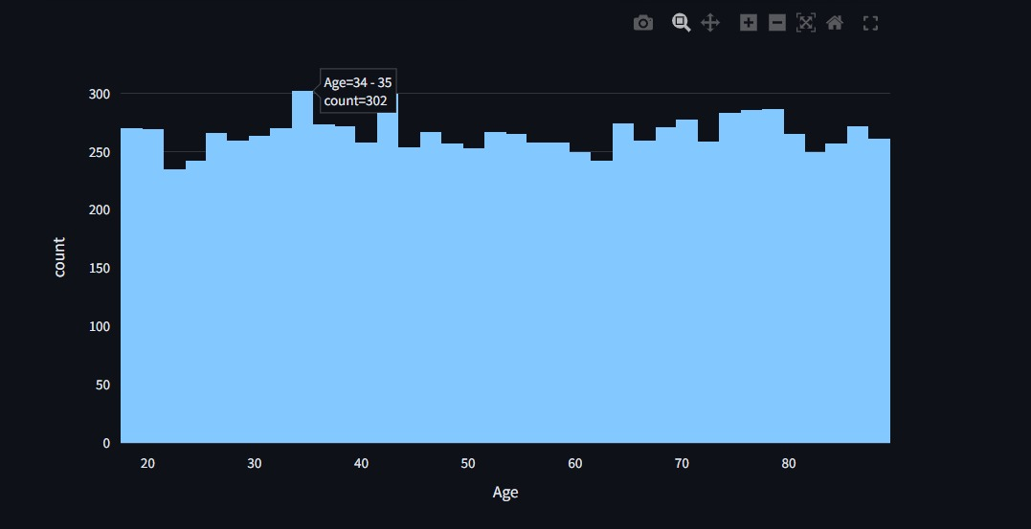

Slide 9
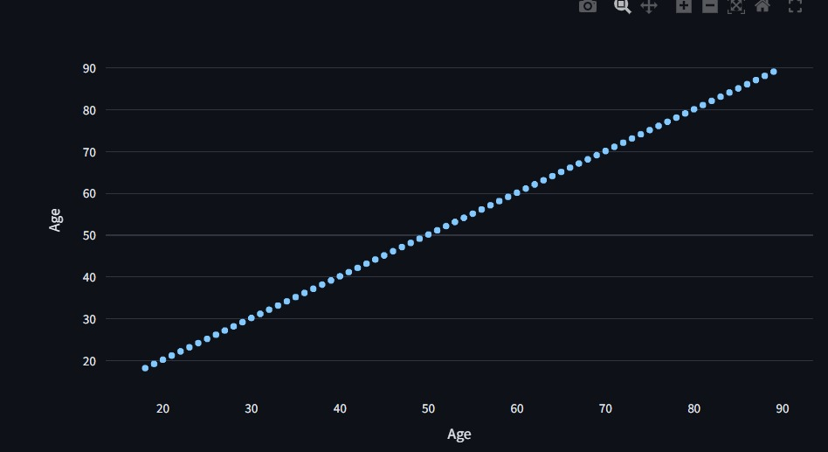
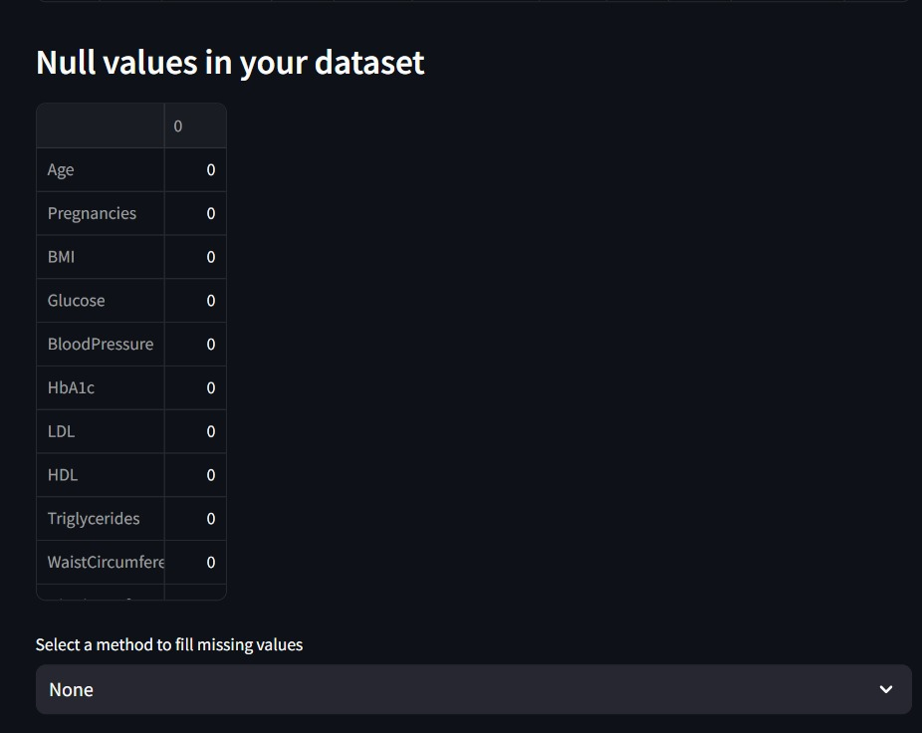

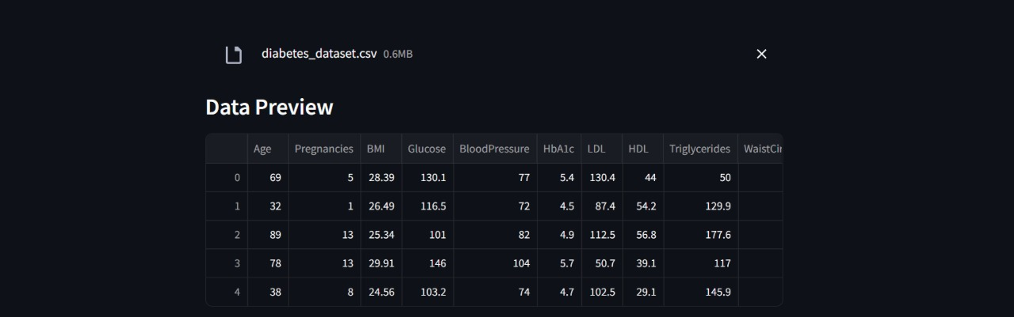

Slide 10

Investment & Growth Opportunity
$77B
SaaS
Market Size
Scalable Model
Data Visualization Software Market by 2027.
Strong recurring revenue.
High
Pricing
Growth Potential
Targeting Fortune 500 and SMBs
Enterprise Plan (Custom Pricing: $500+/month) → API access, custom integrations, and dedicated support

Slide 11
Join the Data Revolution with Illustra
See Illustra in action and unlock the power of your data.

